Slide 1


Fast Food Companies: Deep Performance Analysis
Python for Data Science
Yiyuan Cai
Carlota Martins
Ana Sofia Marroquín
Jakob Spreng
Kevin Parakh

Slide 2

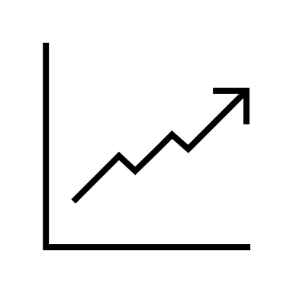




Introduction
Visualization
Line Charts
Bar Charts
Boxplots
Main Goals
Scatter Plots
Analysis of historical stock market performance of 10 major fast-food companies.
Use of Python to explore trends and key metrics across various financial indicators.
Libraries
Pandas
Datetime
Matplotlib
Glob
Seaborn
| 01

Slide 3
Pre-processing
Missing Values Treatment
Duplicates Removal
Outliers Removal
Improve Data Utility
Improve pattern recognition
Preserve statistical measures
*Applied to all 10 Datasets with the use of for-loops*
| 02

Slide 4
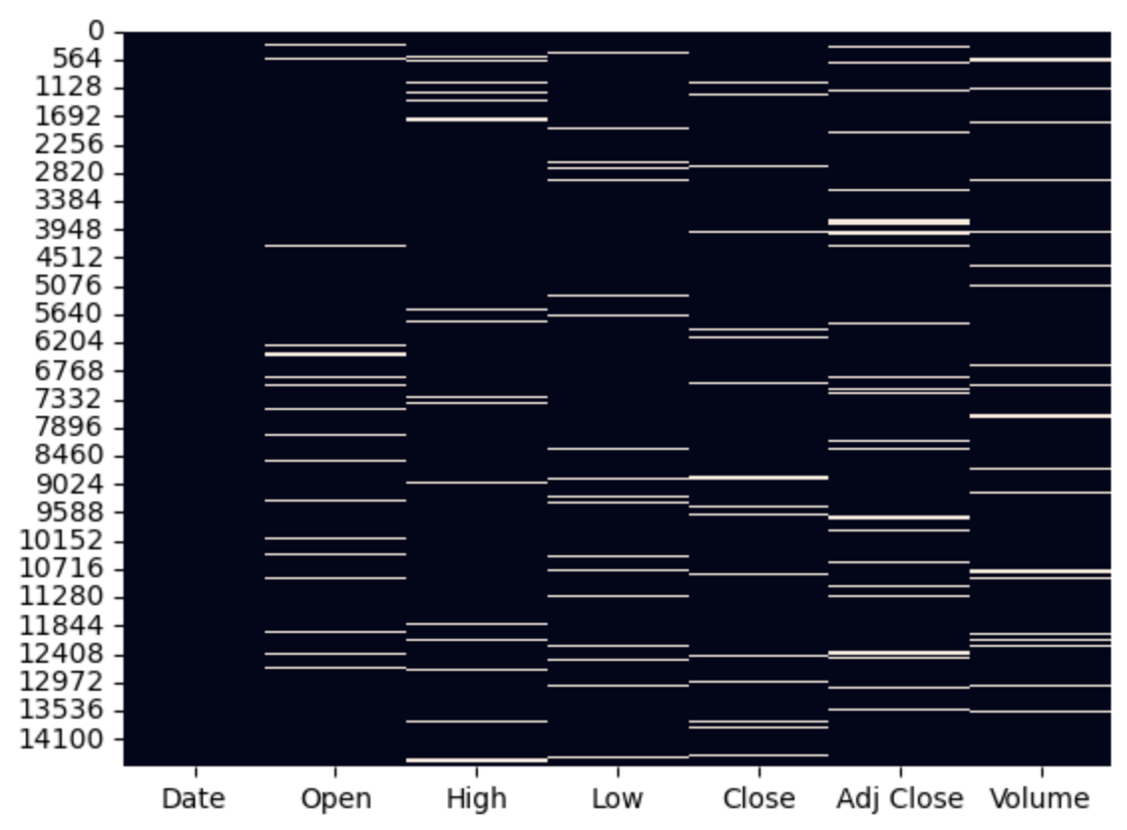
Missing Values Treatment
1. Iterates datasets
2. Linear interpolation
3. Forward-fill - ffill()
4. Backward-fill – bfill()
5. Stored results as new df
Missing Values: MCD
Adj. Close
Date
Open
High
Low
Close
Vol
0
716
719
718
716
715
733
Total Missing Values across 10 datasets: 19724
| 03

Slide 5

Pre-processing
Missing Values Treatment
Duplicates Removal
Outliers Removal
Improve Data Utility
Improve pattern recognition
Preserve statistical measures
Improve graphic visualization
Avoid misleading trends and correlations
Preserve Data Integrity
*Applied to all 10 Datasets with the use of for-loops*
| 04

Slide 6
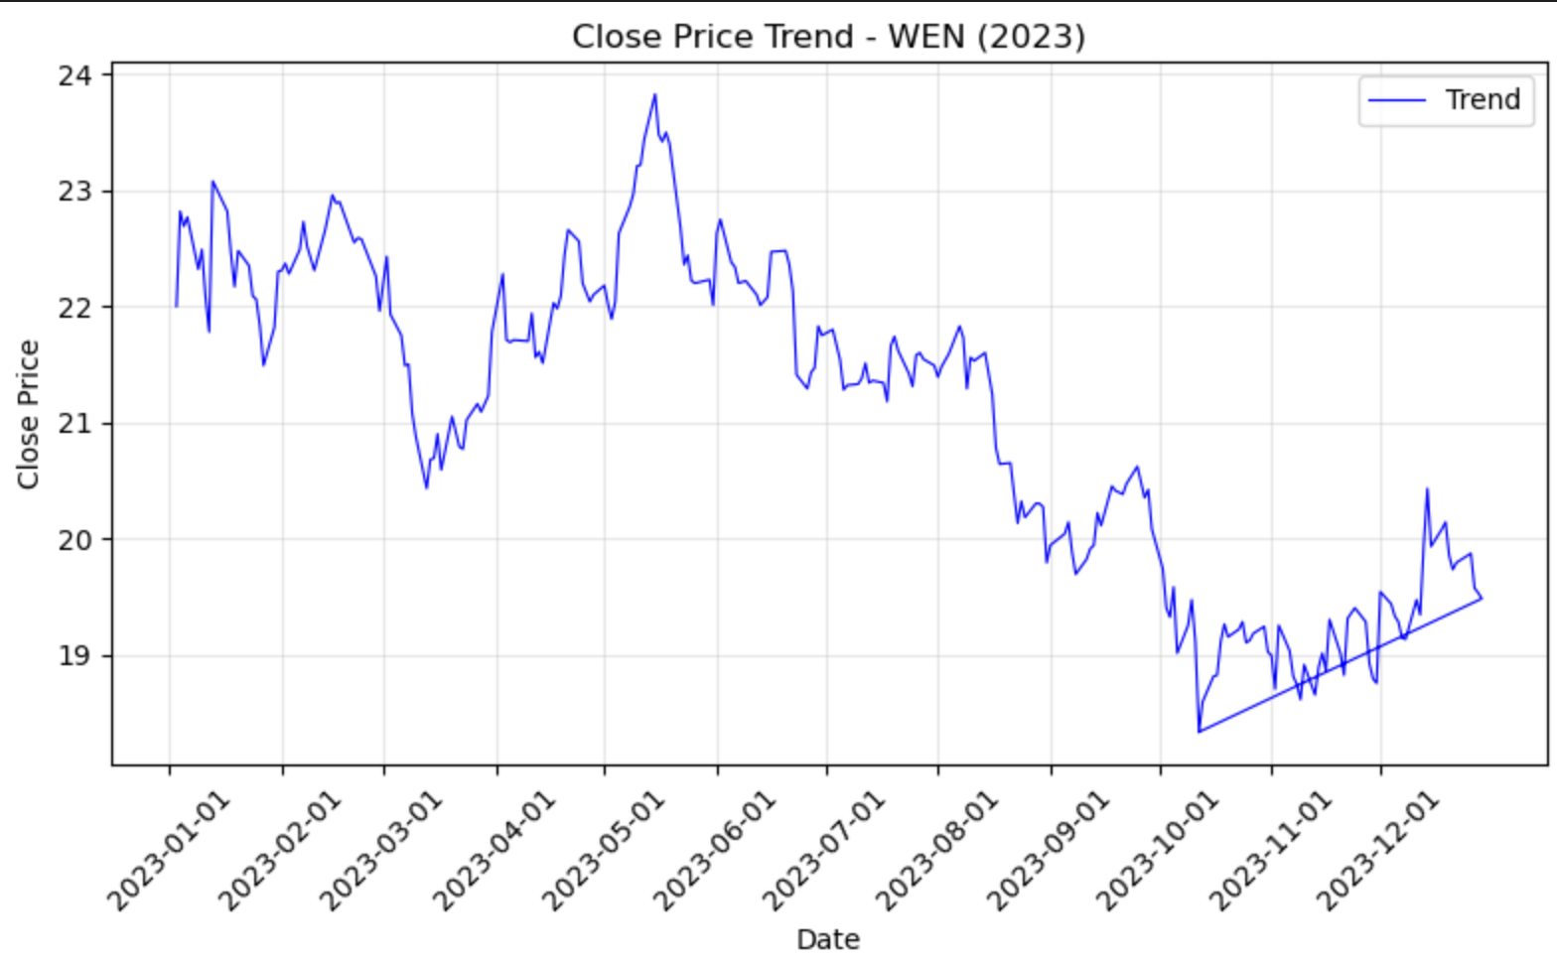
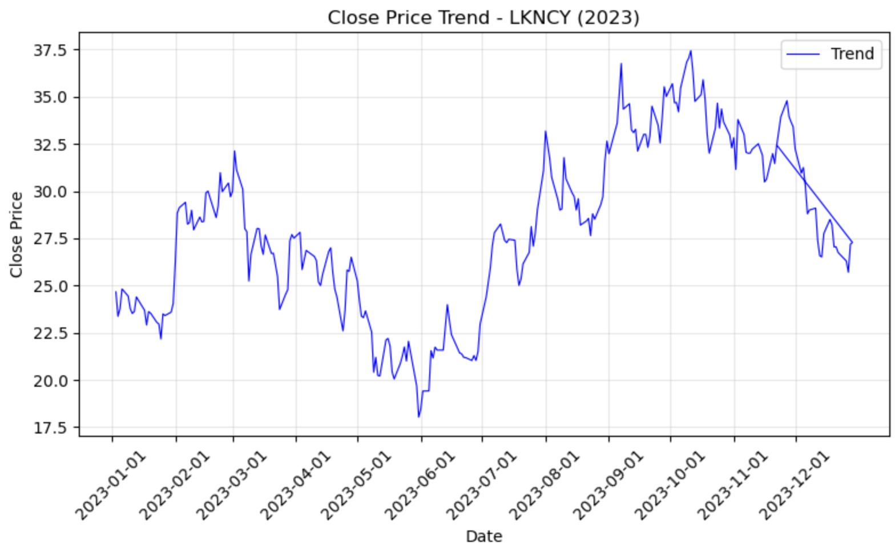
Duplicates Removal
1. Identify Duplicates - data.duplicated().sum()
2. Duplicates Removal – drop_duplicates()
3. Dictionary Update
E.g. Every dataset presented 5 duplicated dates (in exception for QSR)
| 05

Slide 7

Pre-processing
Missing Values Treatment
Duplicates Removal
Outliers Removal
Improve Data Utility
Improve pattern recognition
Preserve statistical measures
Improve graphic visualization
Avoid misleading trends and correlations
Preserve Data Integrity
Calibrate the mean and other statistics
Avoid Misleading Insights
Improve overall model performance
*Applied to all 10 Datasets with the use of for-loops*
| 06

Slide 8
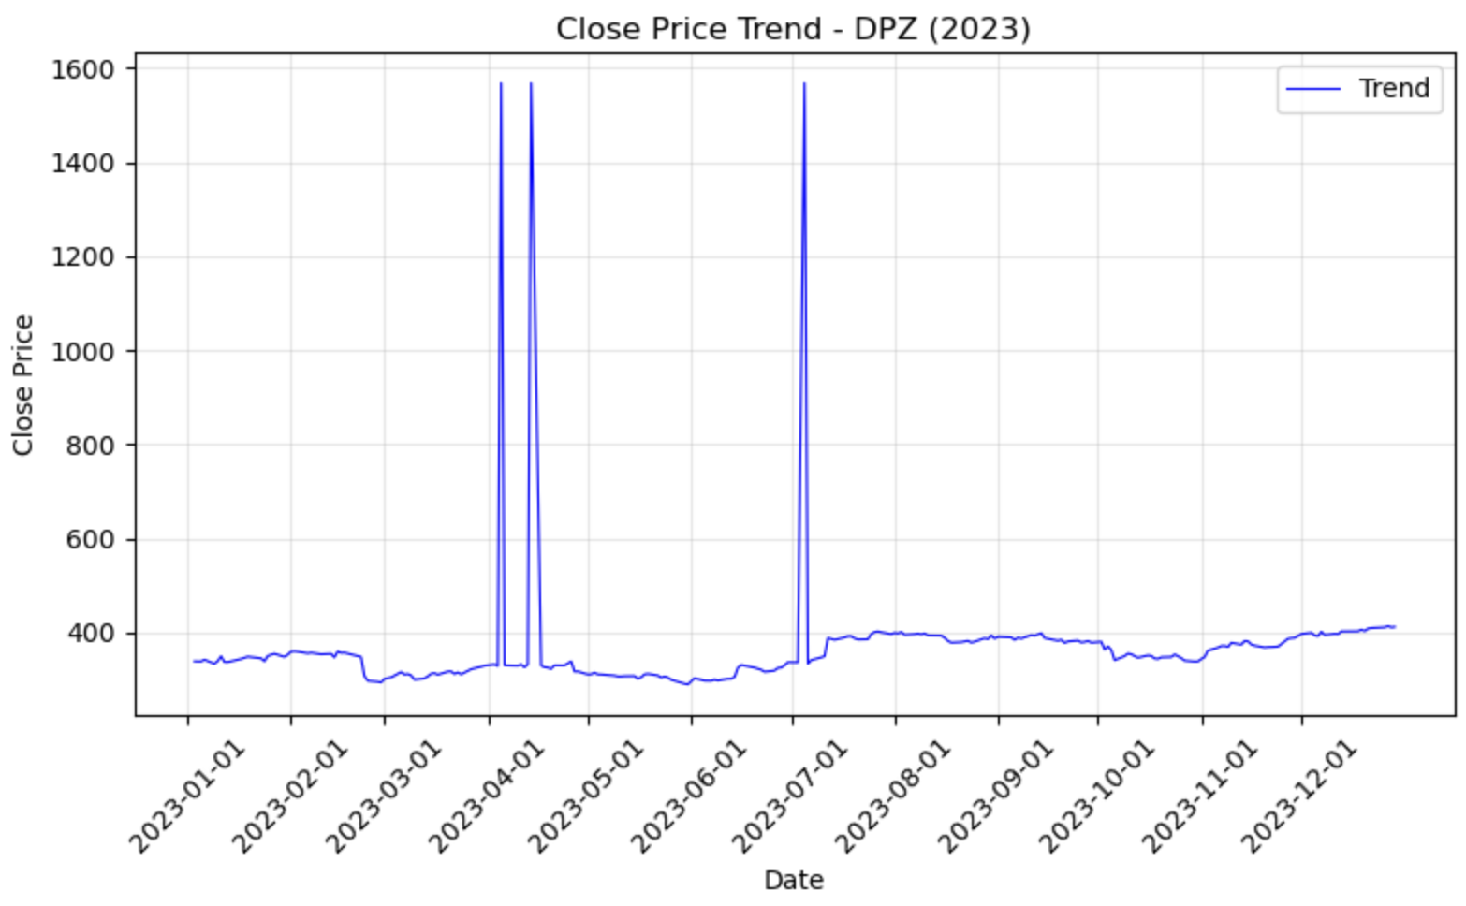
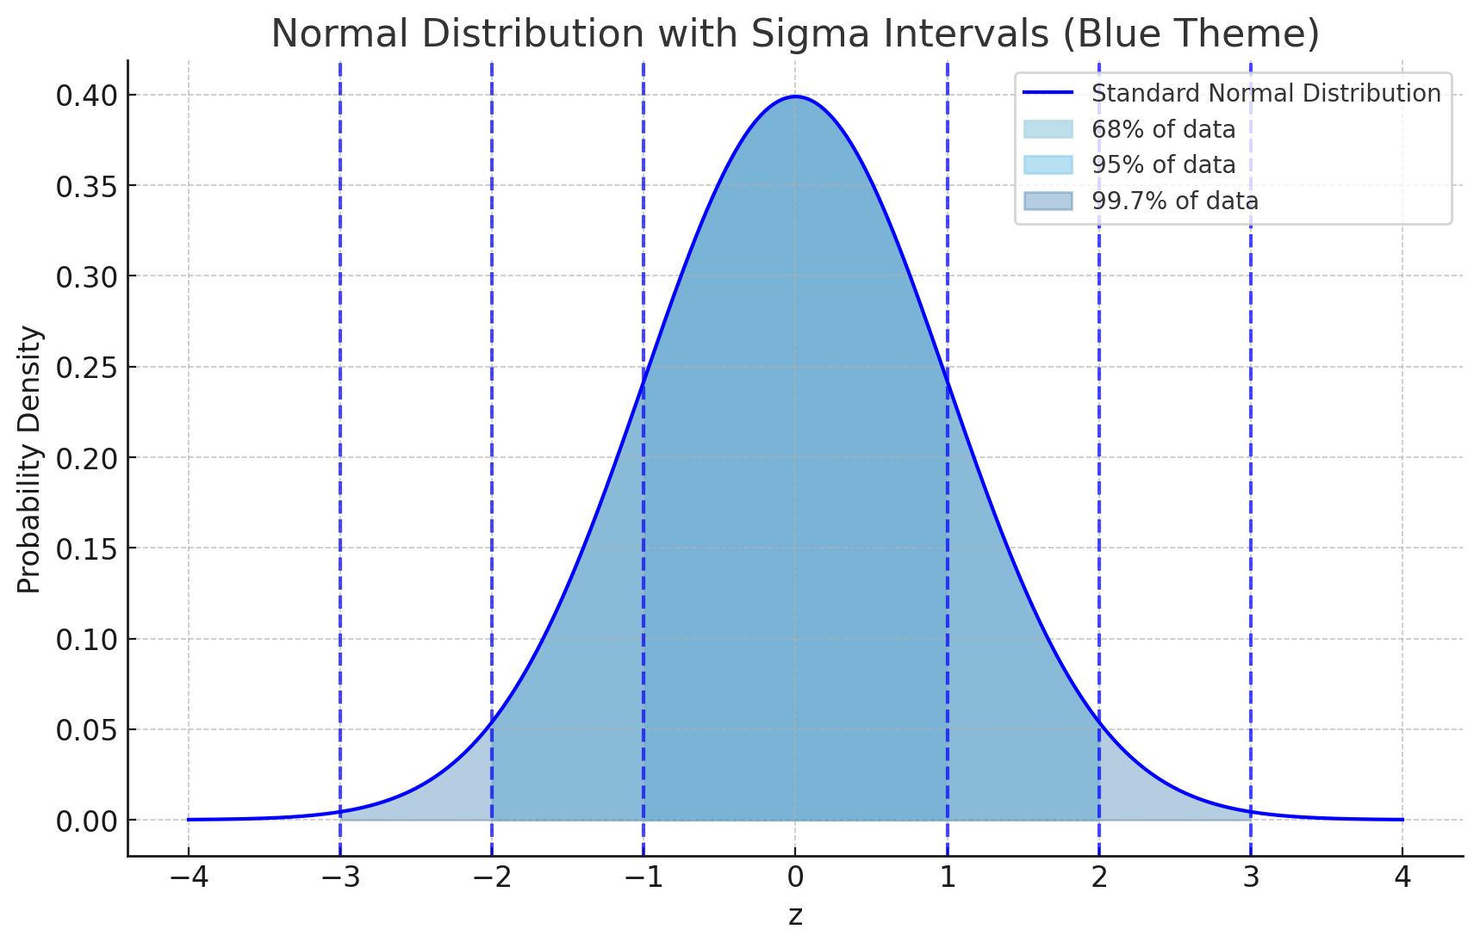
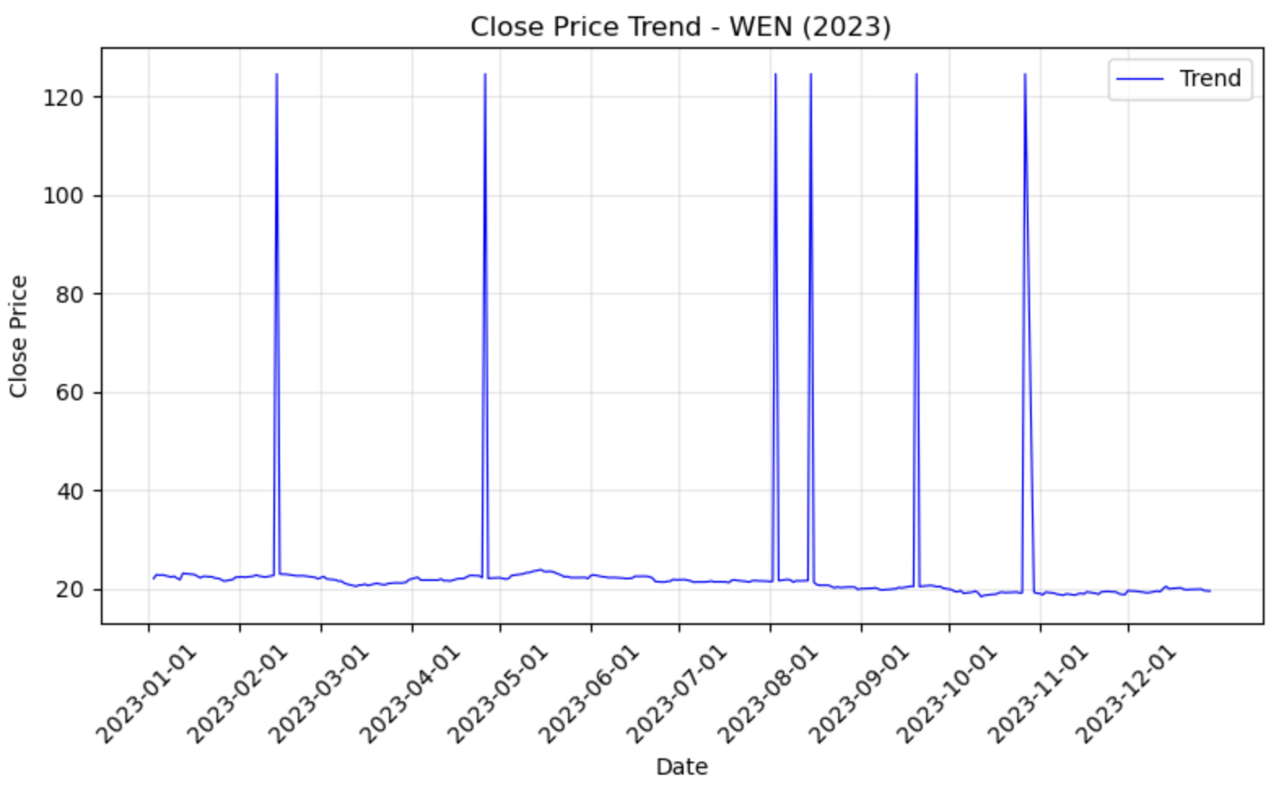
Outliers Removal
IQR Calculation
Outlier Replacement with None
Refill Missing Values
3.1. Linear Interpolation
3.2. Forward Fill
3.3. Backward Fill
Total Number of Outliers across all datasets: 10,678
- Minimum: 61 QSR
- Maximum: 2793 MCD
| 07

Slide 9
Datasets Overview (Ex. 1)
SBUX: Starbucks
DPZ: Domino’s Pizza
MCD: McDonald’s
LKNCY: Luckin Coffee
QSR: Restaurant Brands International
WEN: Wendy’s
PZZA: Papa John’s
YUM: Yum!
BRK-A: Berkshire Hathaway
DNUT: Krispy Kreme
Company
#Rows
SBUX
8117
#Columns
7
DPZ
5083
Date
Object
MCD
14652
Open
float
LKNCY
1345
High
float
QSR
2459
Low
float
WEN
11187
PZZA
7878
Adj Close
float
YUM
6796
Volume
float
BRK-A
11222
DNUT
810
| 08

Slide 10
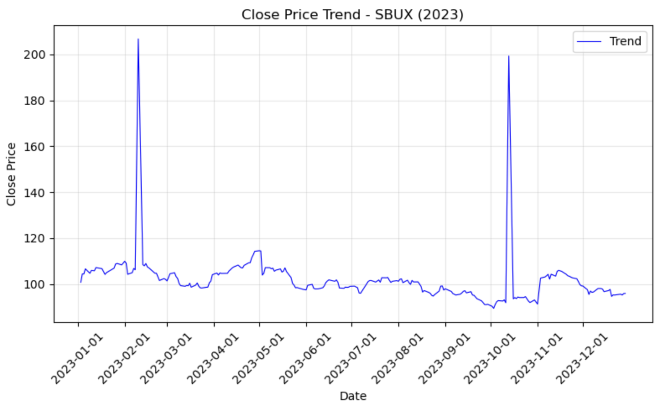
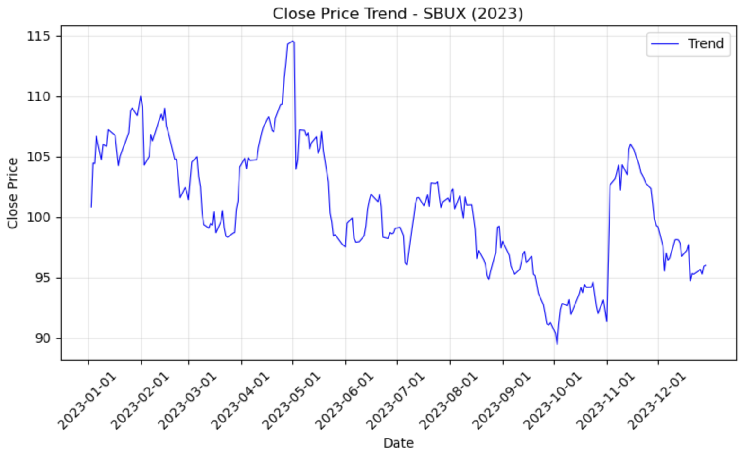
Close Price Visualization for 2023 (Ex. 2)
Approach:
Remaining outliers for SBUX:
Applied IQR and dropped manually
Lowering threshold risks critical data loss for MCD
Line chart:
Identify patterns (increasing, decreasing) price trends
Data Filtering:
.dt.year == 2023
Rows
Each: 250
SBUX: 246
| 9

Slide 11

Day with highest Close Price (Ex. 3)
 | Company | Date | Highest Close Price
1 | SBUX | 2021-10-27 | 209.87
2 | DPZ | 2008-07-14 | 1048.66
3 | MCD | 2013-05-13 | 304.08
4 | LKNCY | 2020-01-17 | 50.02
5 | QSR | 2024-03-13 | 82.75
6 | WEN | 1985-01-02 | 63.45
7 | PZZA | 2016-09-27 | 196.79
8 | YUM | 2017-06-05 | 284.10
9 | BRK-A | 2024-09-03 | 715910
10 | DNUT | 2021-07-01 | 21.00
Steps:
Locate maximum row :
data.loc[data['Close'].idxmax()]
Retrieve Date
max_close_row['Date'].date()
Retrieve Price
max_close_row['Close']
| 10

Slide 12
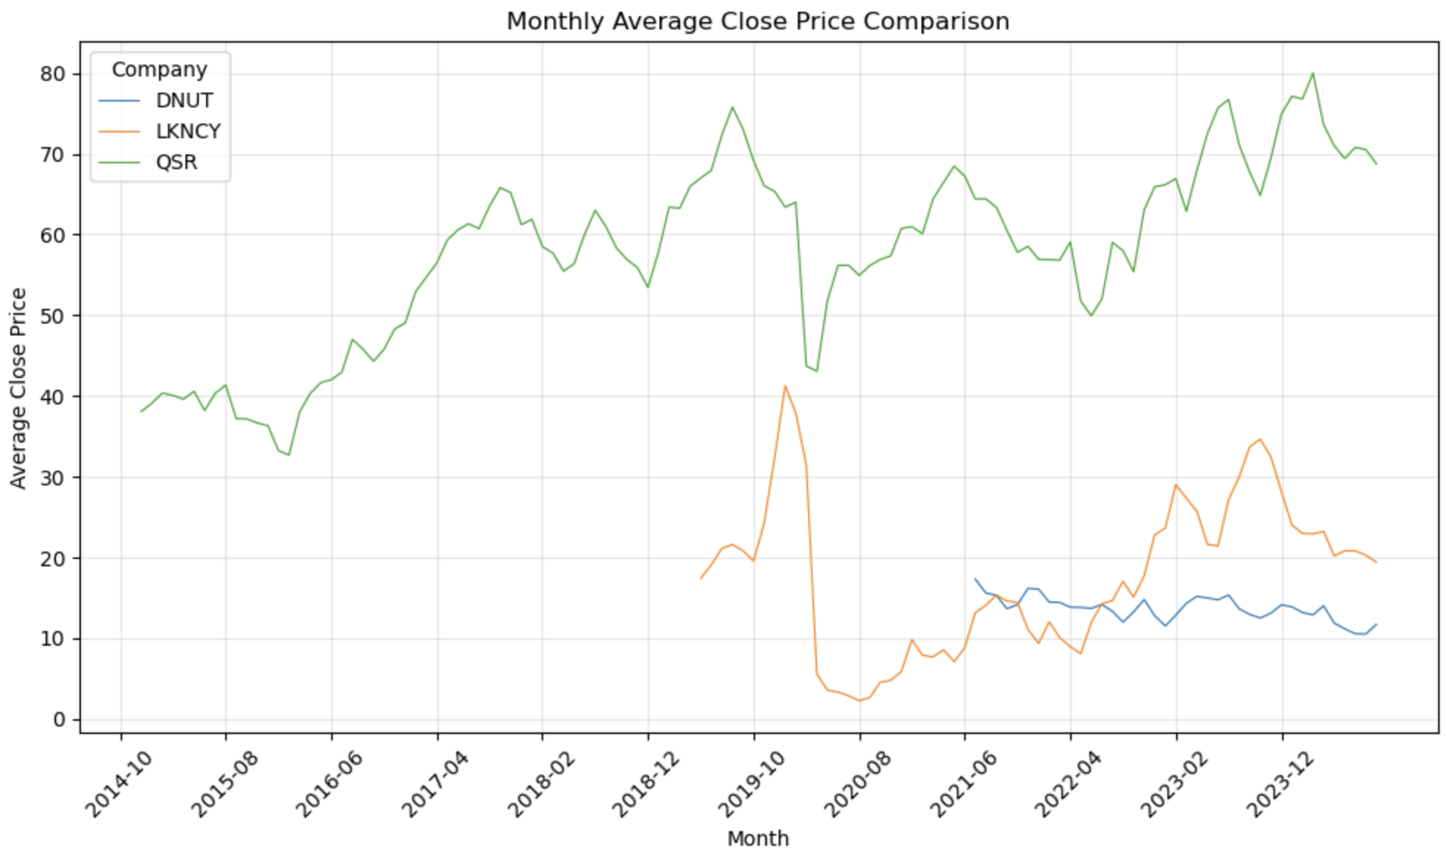
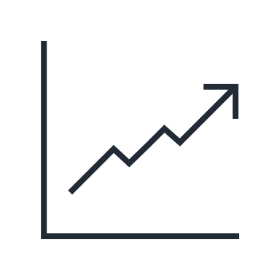



Monthly Average Close Price Comparison (Ex. 4)
Why Line Charts?
1.
Visualization
2.
Company Comparisons
3.
Timeframe Flexibility
4.
Growth & Volatility
Optional: Log-transform
Companies:
Krispy Kreme
Luckin Coffee
Restaurant Brands International
| 02
| 11

Slide 13
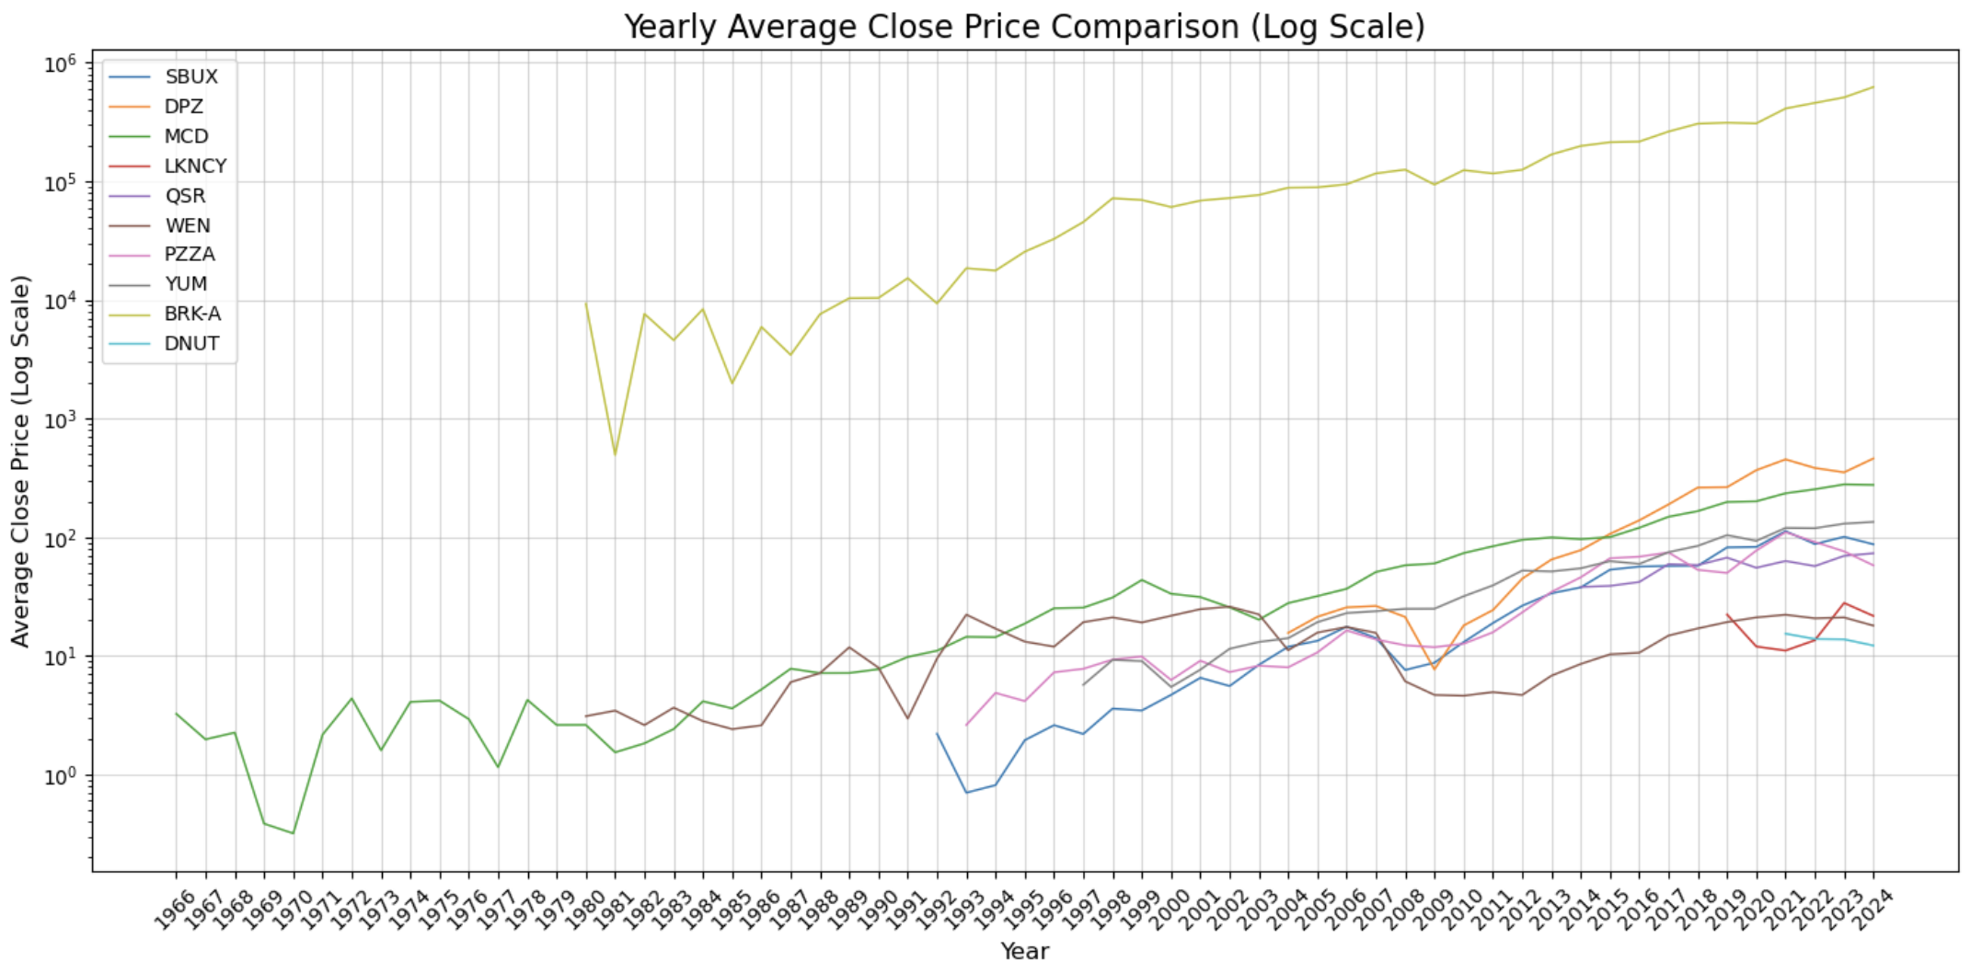
Yearly Average Close Price Comparison (Ex.5)
Justification:
Logarithmic scale :
Compresses large values while maintaining proportion
BRK-A has significantly higher prices
Ensures smaller companies remain visible and comparable
Line chart:
Identify long-term trends, growth patterns, and periods of stability or volatility
| 12

Slide 14
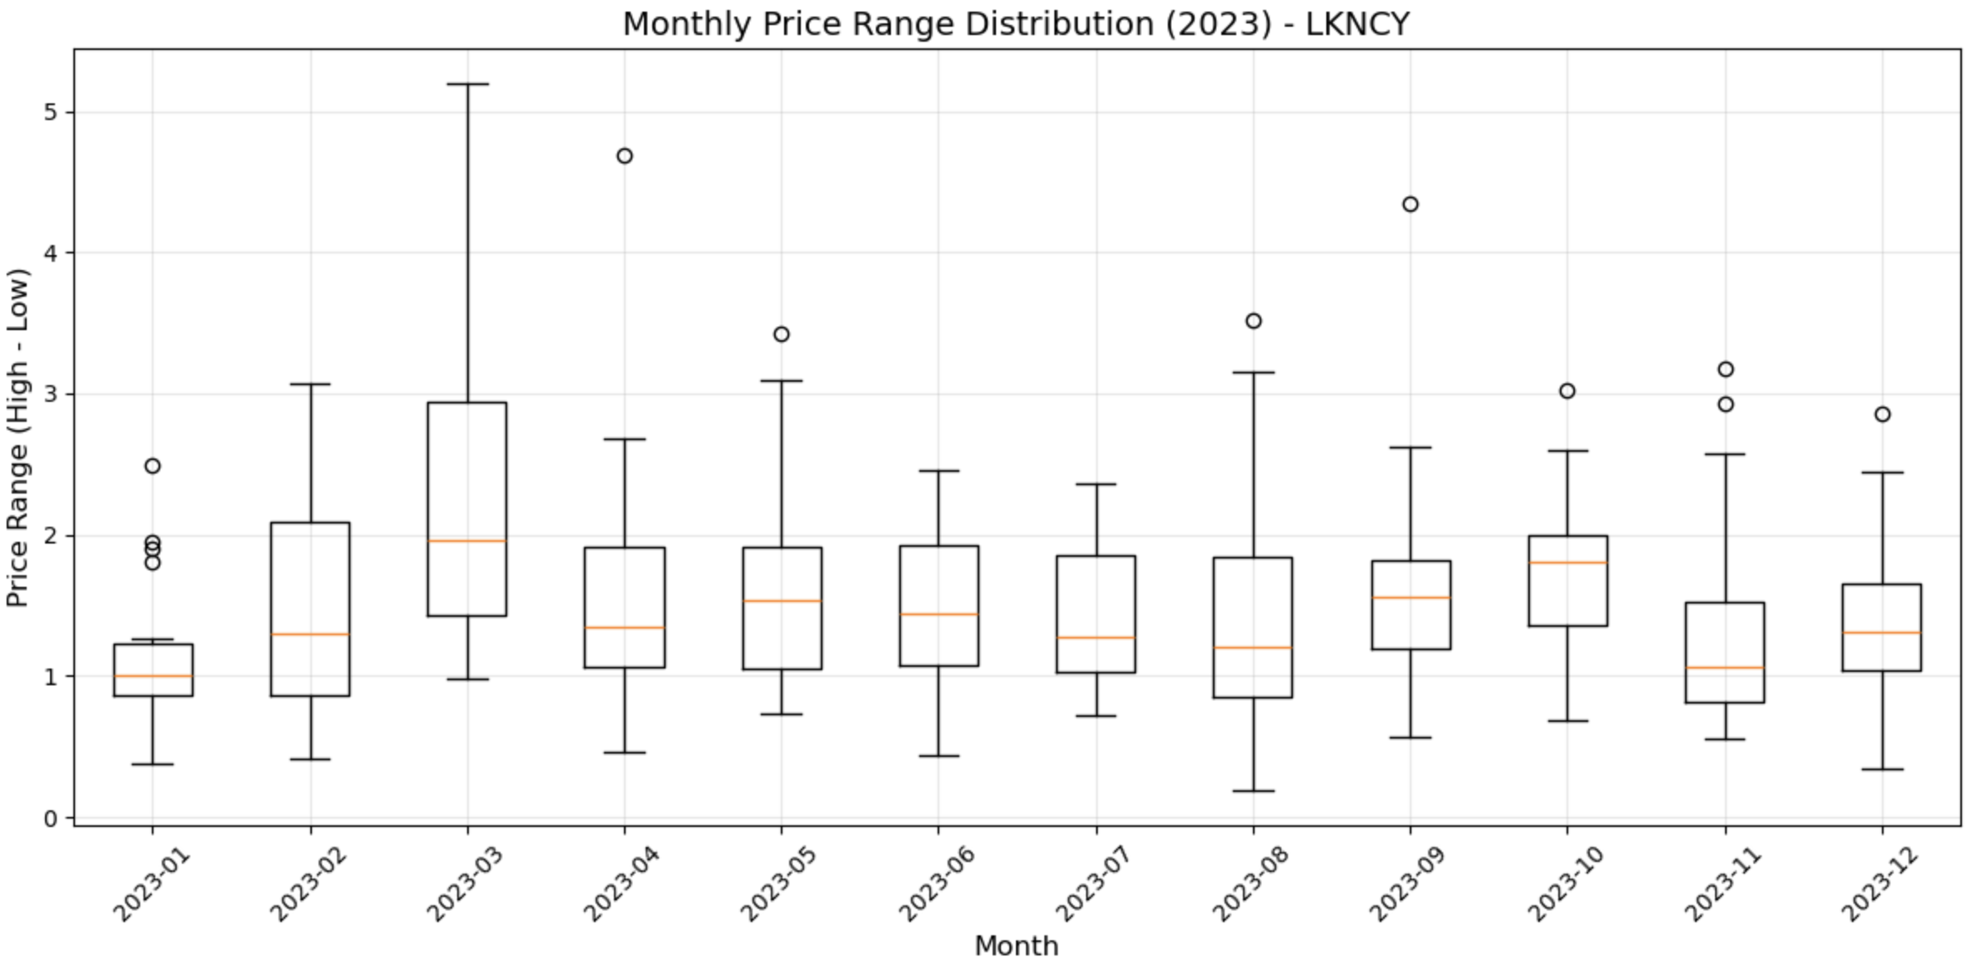
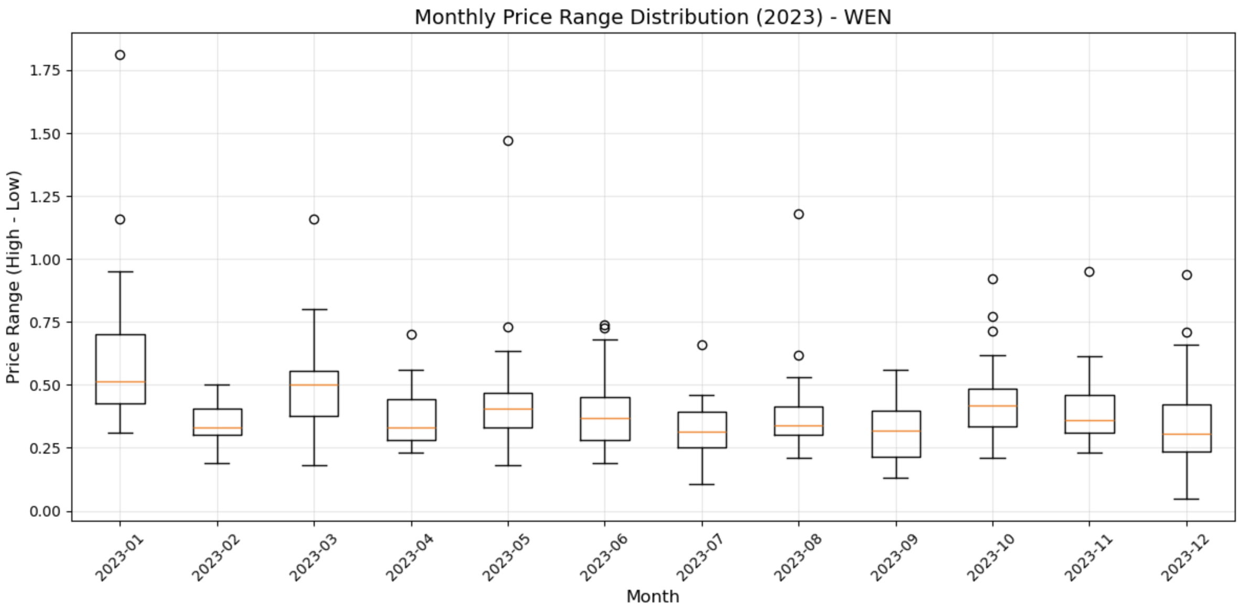
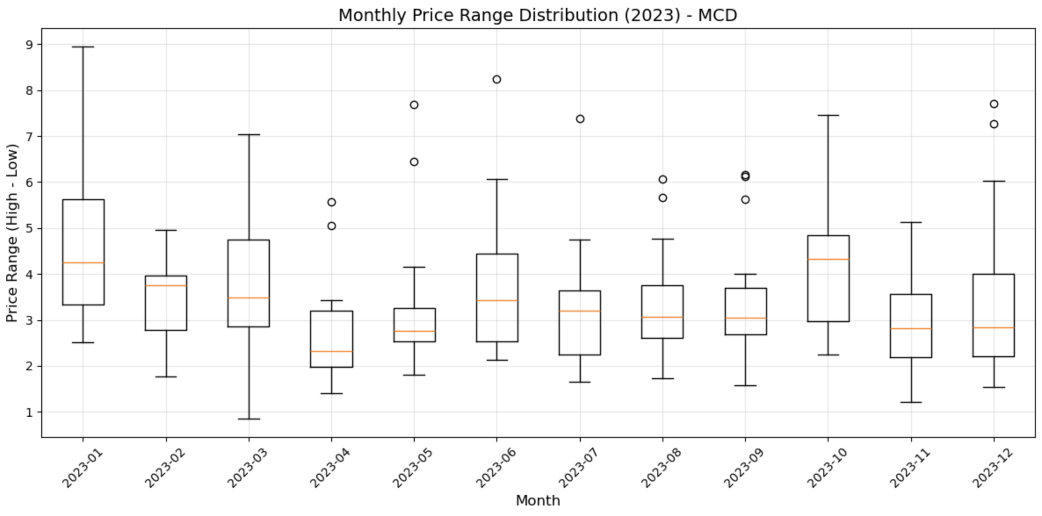
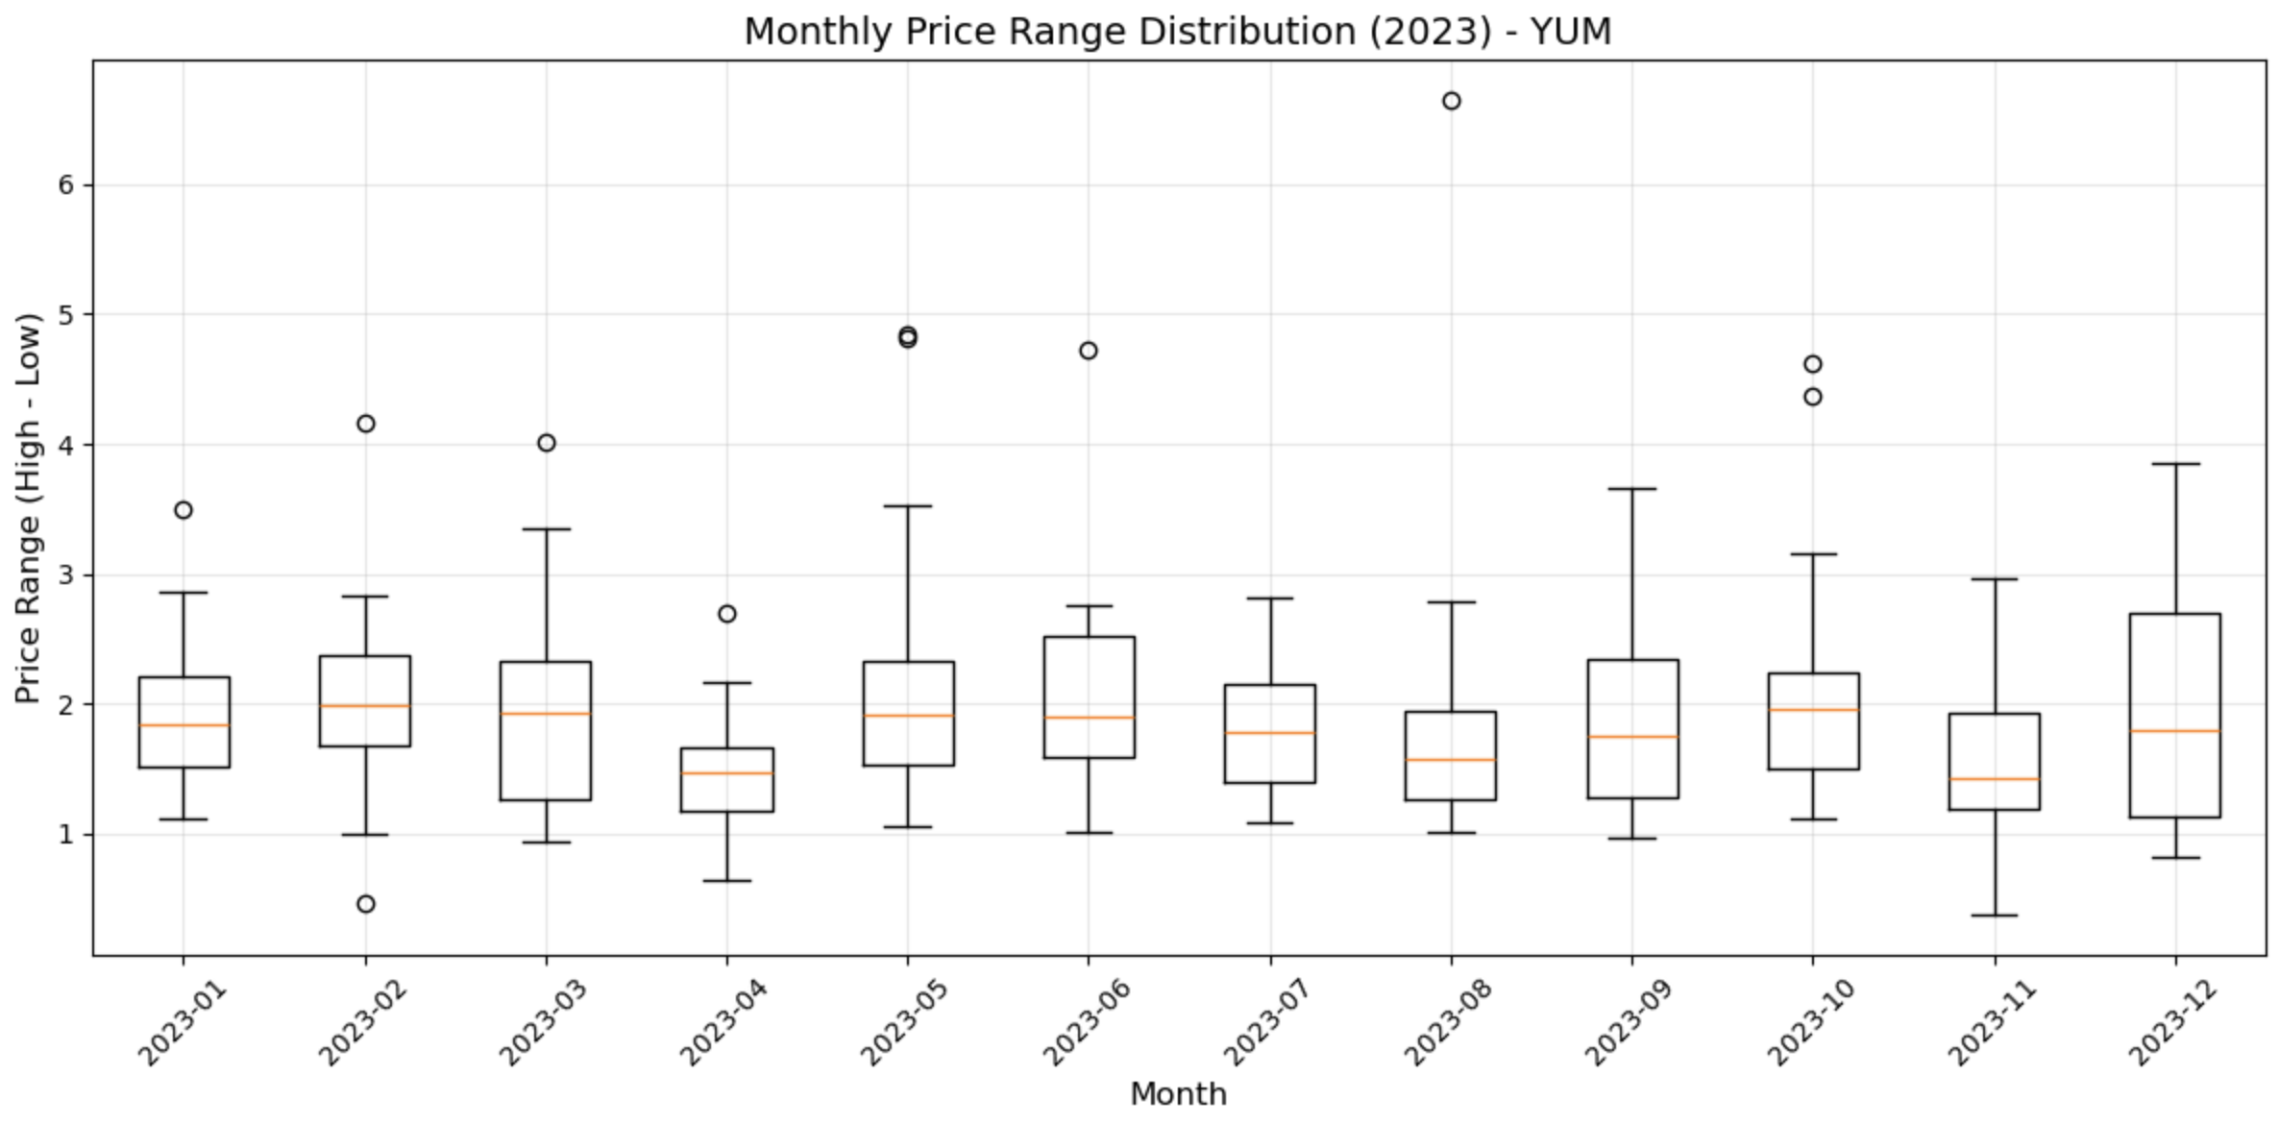
Monthly Price Range Distribution (Ex. 6)
Why Box Plot?
LKNCY
WEN
1.
Summary of monthly price distribution
2.
Side-by-side alignment of box plots
MCD
YUM
3.
Combines multiple key statistics
4.
Outlier identification
Note:
Option Outliers: showfliers=False
One year time span (2023)
| 13

Slide 15
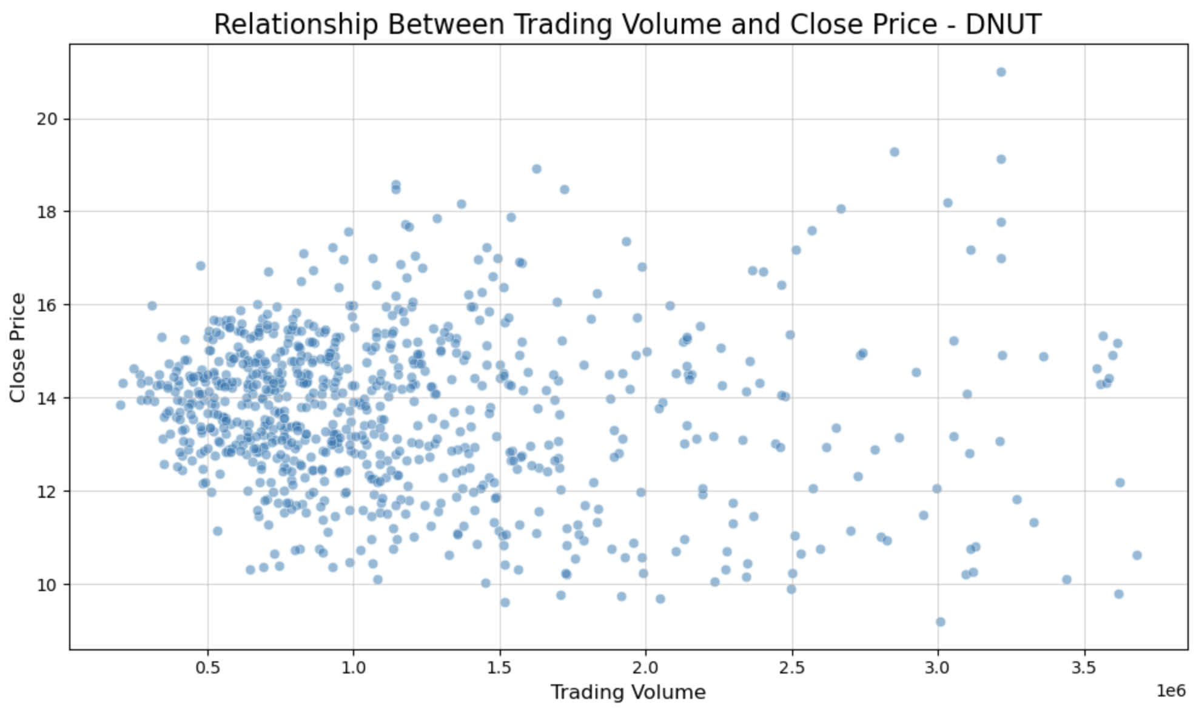

Trading Volume vs. Price (Ex. 7)
Why Scatter Plot?
Visual Relationship
Variability Insight
Trend Detection
Continuous Data Fit
Remarks
The points are scattered, suggesting variability in both trading volume and close price, with a visible concentration in the lower values of trading volume
There is no clear trend or linear relationship visible
Company:
Krispy Kreme
| 14

Slide 16
Month with highest total Trading Volume (Ex. 8)
 | Company | Month | Total Volume
1 | SBUX | January 2008 | 7.825550e+08
2 | DPZ | August 2011 | 2.663795e+07
3 | MCD | October 2008 | 2.830796e+08
4 | LKNCY | January 2020 | 1.986570e+08
5 | QSR | March 2020 | 7.879850e+07
6 | WEN | June 2009 | 1.738654e+08
7 | PZZA | August 2018 | 3.889715e+07
8 | YUM | October 2009 | 1.752880e+08
9 | BRK-A | October 2008 | 2.857517e+06
10 | DNUT | April 2024 | 5.624980e+07
Steps:
Calculate Monthly volume
Retrieve Month
monthly_volume.idxmax()
Retrieve Volume
monthly_volume.max()
| 15

Slide 17

Structure of merged Dataset (Ex. 9)
 | Column | Non-Null Count | Dtype
1 | Date | 69545 non-null | datetime64[ns]
2 | Open | 69545 non-null | float64
3 | High | 69545 non-null | float64
4 | Low | 69545 non-null | float64
5 | Close | 69545 non-null | float64
6 | Adj Close | 69545 non-null | float64
7 | Volume | 69545 non-null | float64
8 | Year Month | 69545 non-null | Period[M]
9 | Year | 69545 non-null | int32
10 | Company | 69545 non-null | object
Insights:
Merged all datasets into one
One for each year
First Dataset: 1966
Last Dataset: 2024
Dataset contains 0 missing value: missing_summary = group.isnull().sum()
69545 is the number of price data across 58 years from 10 companies
| 16

Slide 18
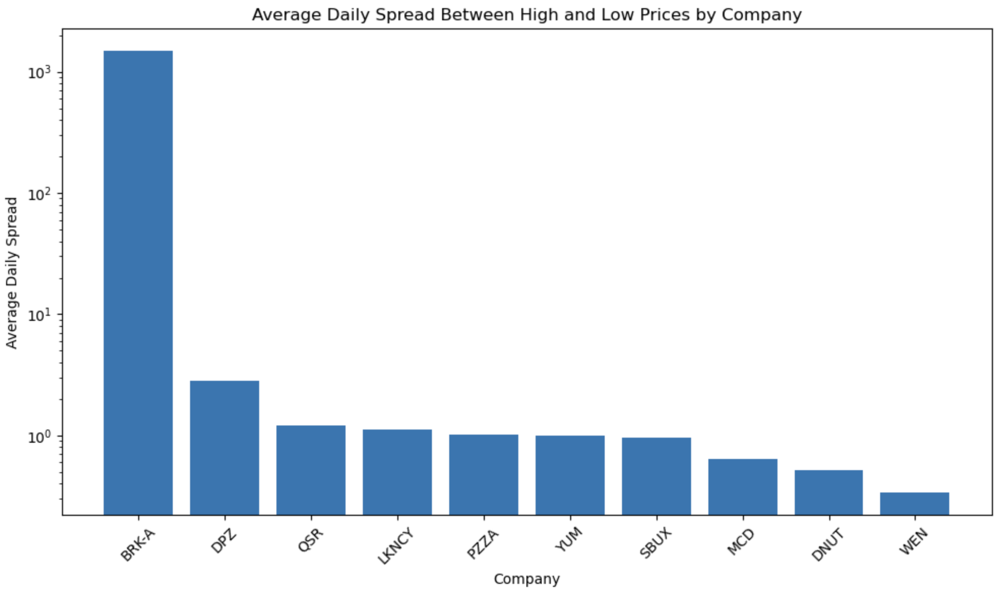
Daily average spread between high and low prices (Ex. 10)
Advantages of Log Bar Charts
1,484
1.
Actual Value
Manages Large Scalability
Compresses large values (e.g. BRK-A) while expanding smaller ones, ensuring visibility of smaller spreads
2.
Enhances Balance
Prevents smaller categories from appearing insignificant
2.83
1.21
1.13
1.01
0.99
0.95
0.64
0.52
3.
Emphasizes Proportions
0.34
Highlights relative differences, making patterns across diverse values clearer
| 17

Slide 19

Final Remarks
Data Handling
Cleaning, filtering, and transforming data ensure accuracy and relevance of the analysis
Technical Methods
Using grouping and log scales help to focus on important details in the data
Effective Visualizations
Charts like line graphs and box plots make complex data, easy to interpret.
| 18

